Slide 1
Bike Share Availability Prediction in London

Slide 2
About Me
Muhammad Ismail Muchfi Herman Aji
Student JCDS 10 Purwadhika Jakarta
Graduate with Double Degree from Universitas Gadjah Mada and Flinders University in International Relations

Slide 3
Table of Contents
01
02
03
04
05
06
Background
Problem and Goal
Data Information
Data Analysis
Conclusion
Suggestions

Slide 4

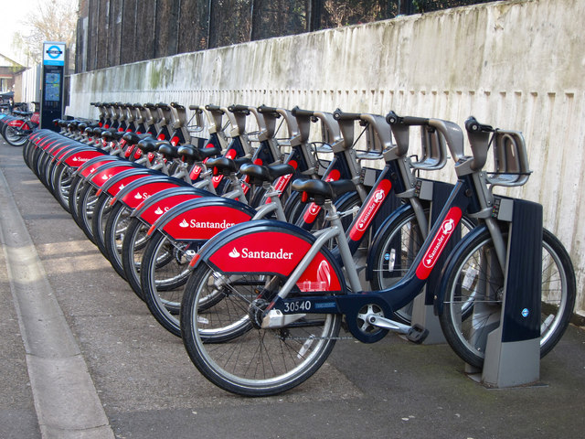
01
Background

Slide 5
Background
As London is the center of business hub and the place of Central Government in United Kingdom, it becomes one of the busiest city in the world. People moves from places to places with public transport which sometimes can be overcrowded. In 2008 the Mayor of London came up with an idea to introduce bike share scheme in which to provide another type of transportation for the people of London with accessibility to public transport.
Bike share is a public bike hire scheme where people can hire the bike with an application from the bike dock or a dockless bike and it cost very little. Making people easily access the bike to move from places to places.

Slide 6
02
Problems and Goals

Slide 7
Problems and Goals
With the government encouraging people to using bike share and the demand of bike share keep going up, it can lead to the absence of bike that available for rent
The emergence of another bike share company which people would choose if the bike’s company is not available can led to potential loss of a consument
Exploring data to find in which time between 2015 - 2017 is the busiest, based on the hour, day, month, weather, season, wind speed, temperature and humidity.
Create a machine learning to predict how many bikes the company needed per hour.

Slide 8
03
Data Information

Slide 9
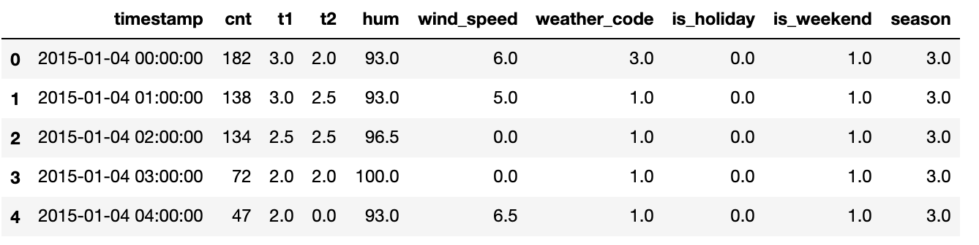
The data that use in this project is from https://www.kaggle.com/hmavrodiev/london-bike-sharing-dataset which the owner get from https://cycling.data.tfl.gov.uk/

Slide 10
- "timestamp" - timestamp field for grouping the data
- "cnt" - the count of a new bike shares
- "t1" - real temperature in C
- "t2" - temperature in C "feels like"
- "hum" - humidity in percentage
- "windspeed" - wind speed in km/h
- "weathercode" - category of the weather
- "isholiday" - boolean field - 1 holiday / 0 non holiday
- "isweekend" - boolean field - 1 if the day is weekend
- "season" - category field meteorological seasons: 0-spring ; 1-summer; 2-fall; 3-winter.
- "weathe_code" category description:
- 1 = Clear ; mostly clear but have some values with haze/fog/patches of fog/ fog in vicinity 2 = scattered clouds / few clouds 3 = Broken clouds 4 = Cloudy 7 = Rain/ light Rain shower/ Light rain 10 = rain with thunderstorm 26 = snowfall 94 = Freezing Fog

Slide 11
04
Data Analysis

Slide 12
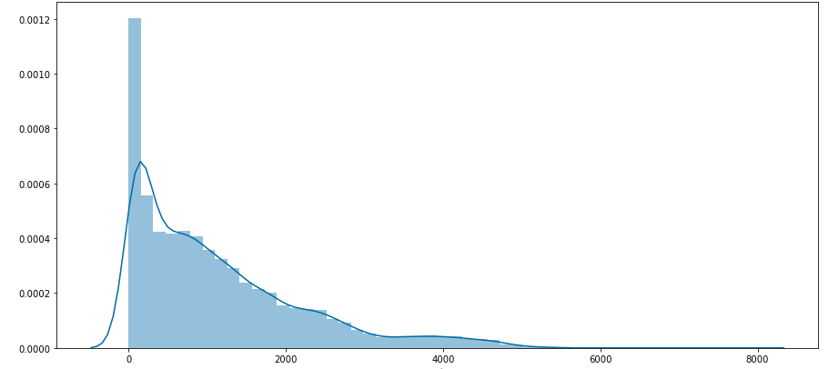
Target

Slide 13
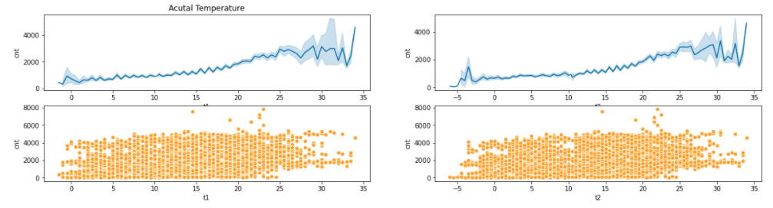
Bike Share by Actual Temperature
Bike Share by Feels Like

Slide 14
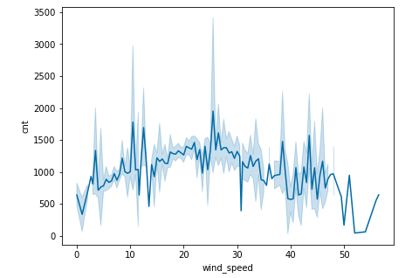
Bike Share by Wind Speed

Slide 15
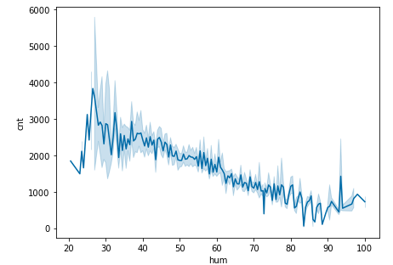
Bike Share by Humidity

Slide 16
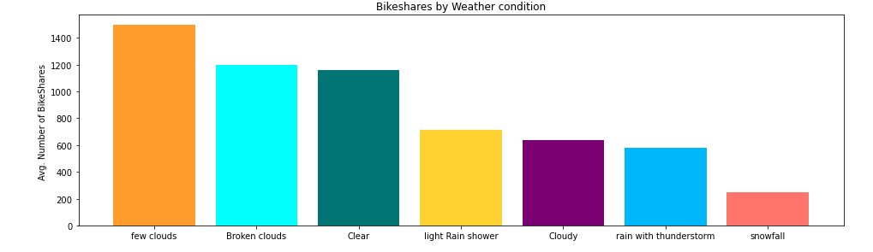
Bike Share by Weather

Slide 17
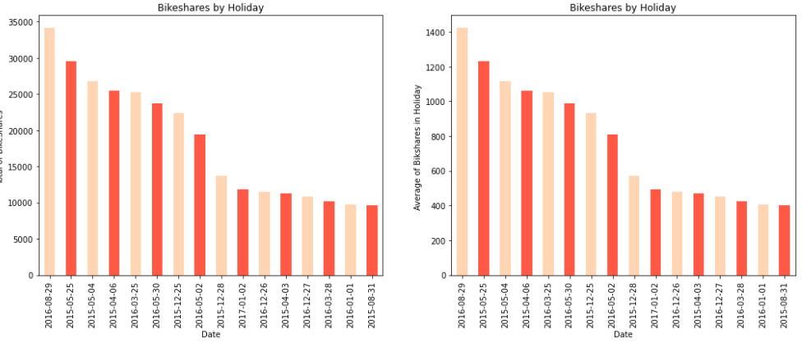
Bike share by holiday

Slide 18
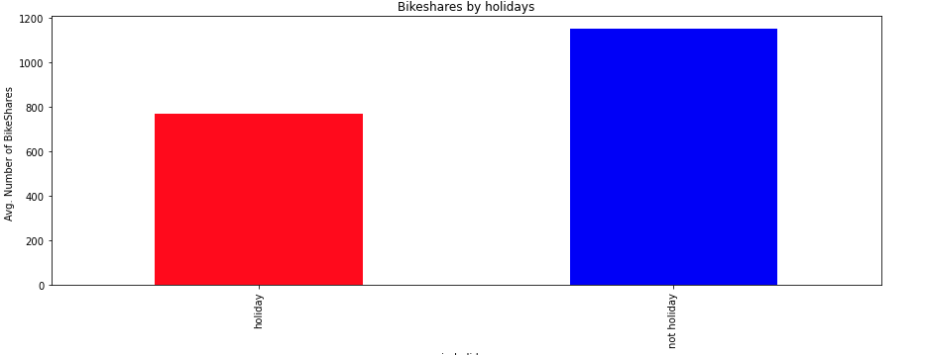
Comparison of between Holiday and Non Holiday

Slide 19
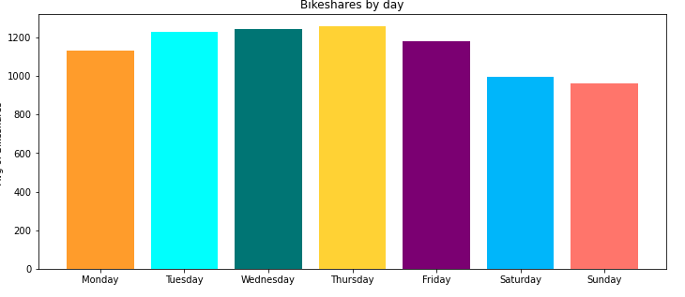
Bike Share by Day

Slide 20
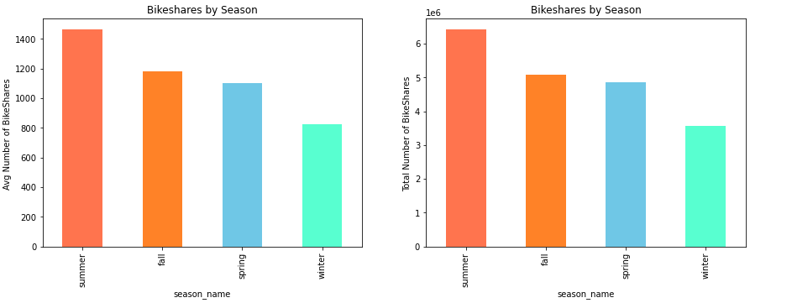
Bike Share by Season

Slide 21
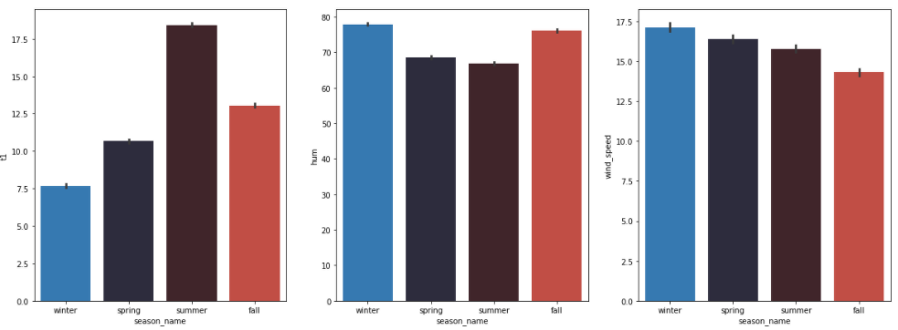
Analysis on why summer is the best season

Slide 22
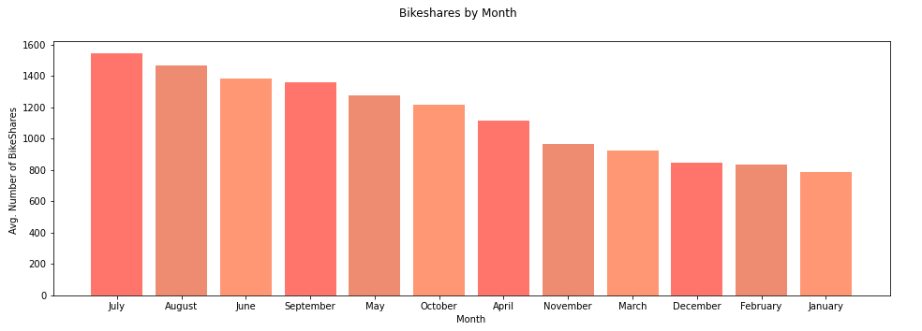
Bike Share by Month

Slide 23
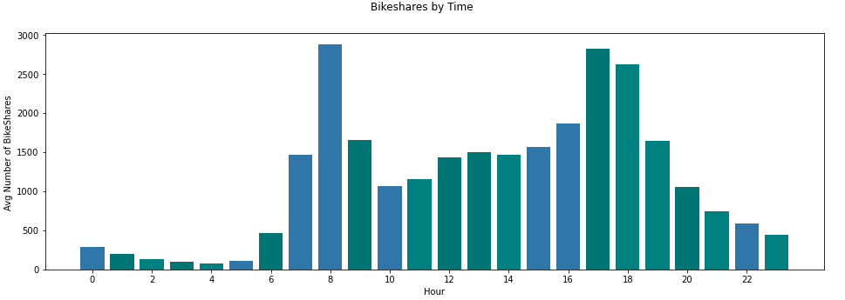
Bike Share per Hour

Slide 24
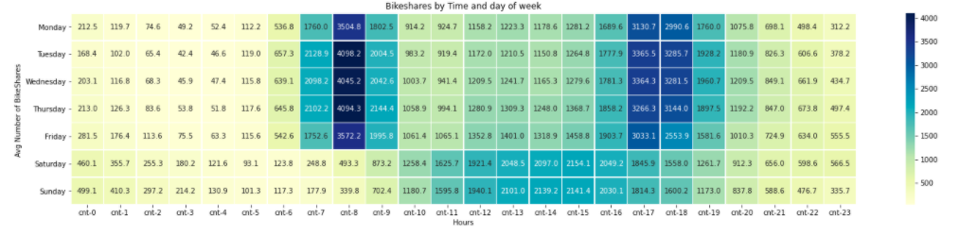
Bike Share by Time and Day

Slide 25
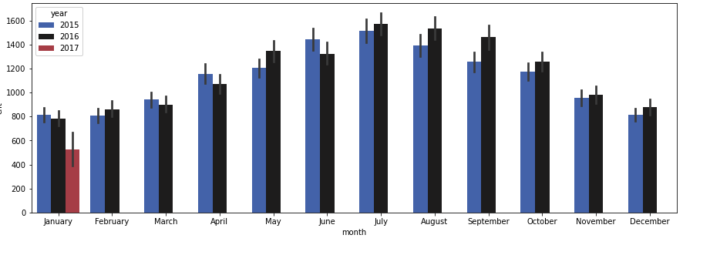
Bike Share per Year

Slide 26
Conclusion
Based on the dataset according to count column which is the target shown that the Skewness is positive which mean the distribution is located on the highest value. In this case most of the bike share usage distribution have a low value and the mean is higher than median. Which shows that bike usage in London through 2015 - 2016 and early 2017 are lower than the average and several days the people hiring bike is very high

Slide 27
Analysis
Based on the analysis the people rike to ride bike in the warmer temperature, which around 15-20s degrees, as it is the ideal temperature to ride a bike and the London average temperature is around 17 degree celsius
Few clouds, broken clouds and clear weather are where people like to use the bike share
Weekdays are far busier than weekend and holiday, as people use the bike for commute
The busiest time of people using bike share is at 8 o'clock and 17 o’clock where people go to work and going home
Thursday is the most popular day for people to use bike share
Summer is the most popular season for people to use bike share as the temperature in London is not that hot and cold, meaning that June, July and August are the most popular month for people to ride the bike share
In 2016 most of the month have an increase in bike share usage
Except, March, April and June. Where in June there was flood in London

Slide 28
Suggestion
As weekday is very busy, especially in 8 in the morning and 5 in the evening, the company should provide more bike in this hour
With summer become the most popular season the company should prepare more bike within period of June, July and August
If the company want to do maintenance of the bike, suggesting do it in the weekend or holiday as it is not too busy for people to commute
The company need to check on the daily weather, as there are several weather which people prefer to ride a bike
Use the machine learning to make sure how many bike does the company needed in specific temperature, weather, day, month, hour, wind speed and humidity

Slide 29
Thanks
Do you have any questions?
muchfihermanaji@gmail.com
081221294787
Please keep this slide for attribution

Slide 30
Resources
https://blog.metoffice.gov.uk/2012/02/15/what-is-feels-like-temperature/#:~:text=Our%20'feels%20like'%20temperature%20takes,human%20body%20actually%20feels%20temperature.&text=Conversely%20on%20a%20humid%20day,would%20suggest%20on%20their%20own.
https://www.gov.uk/bank-holidays
https://www.accuweather.com/en/weather-news/what-are-the-best-worst-weather-conditions-for-cycling-2/432641#:~:text=Some%20would%20prefer%20to%20ride,most%2C%20according%20to%20USA%20Cycling.
https://www.independent.co.uk/news/uk/home-news/uk-weather-london-flooding-floods-south-east-pictures-forecast-a7097316.html
https://www.theguardian.com/cities/2019/feb/22/life-cycle-is-it-the-end-for-britains-dockless-bike-schemes
https://tfl.gov.uk/modes/cycling/santander-cycles

Slide 31
Bike Share Availability Prediction in London

Slide 32
About Me
Muhammad Ismail Muchfi Herman Aji
Student JCDS 10 Purwadhika Jakarta
Graduate with Double Degree from Universitas Gadjah Mada and Flinders University in International Relations

Slide 33
Table of Contents
01
02
03
04
05
06
Background
Problem and Goal
Data Information
Data Analysis
Conclusion
Suggestions

Slide 34
01
Background

Slide 35
Background
As London is the center of business hub and the place of Central Government in United Kingdom, it becomes one of the busiest city in the world. People moves from places to places with public transport which sometimes can be overcrowded. In 2008 the Mayor of London came up with an idea to introduce bike share scheme in which to provide another type of transportation for the people of London with accessibility to public transport.
Bike share is a public bike hire scheme where people can hire the bike with an application from the bike dock or a dockless bike and it cost very little. Making people easily access the bike to move from places to places.

Slide 36
02
Problems and Goals

Slide 37
Problems and Goals
With the government encouraging people to using bike share and the demand of bike share keep going up, it can lead to the absence of bike that available for rent
The emergence of another bike share company which people would choose if the bike’s company is not available can led to potential loss of a consument
Exploring data to find in which time between 2015 - 2017 is the busiest, based on the hour, day, month, weather, season, wind speed, temperature and humidity.
Create a machine learning to predict how many bikes the company needed per hour.

Slide 38
03
Data Information

Slide 39
The data that use in this project is from https://www.kaggle.com/hmavrodiev/london-bike-sharing-dataset which the owner get from https://cycling.data.tfl.gov.uk/

Slide 40
- "timestamp" - timestamp field for grouping the data
- "cnt" - the count of a new bike shares
- "t1" - real temperature in C
- "t2" - temperature in C "feels like"
- "hum" - humidity in percentage
- "windspeed" - wind speed in km/h
- "weathercode" - category of the weather
- "isholiday" - boolean field - 1 holiday / 0 non holiday
- "isweekend" - boolean field - 1 if the day is weekend
- "season" - category field meteorological seasons: 0-spring ; 1-summer; 2-fall; 3-winter.
- "weathe_code" category description:
- 1 = Clear ; mostly clear but have some values with haze/fog/patches of fog/ fog in vicinity 2 = scattered clouds / few clouds 3 = Broken clouds 4 = Cloudy 7 = Rain/ light Rain shower/ Light rain 10 = rain with thunderstorm 26 = snowfall 94 = Freezing Fog

Slide 41
04
Data Analysis

Slide 42
Target

Slide 43
Bike Share by Actual Temperature
Bike Share by Feels Like

Slide 44
Bike Share by Wind Speed

Slide 45
Bike Share by Humidity

Slide 46
Bike Share by Weather

Slide 47
Bike share by holiday

Slide 48
Comparison of between Holiday and Non Holiday

Slide 49
Bike Share by Day

Slide 50
Bike Share by Season

Slide 51
Analysis on why summer is the best season

Slide 52
Bike Share by Month

Slide 53
Bike Share per Hour

Slide 54
Bike Share by Time and Day

Slide 55
Bike Share per Year

Slide 56
Conclusion
Based on the dataset according to count column which is the target shown that the Skewness is positive which mean the distribution is located on the highest value. In this case most of the bike share usage distribution have a low value and the mean is higher than median. Which shows that bike usage in London through 2015 - 2016 and early 2017 are lower than the average and several days the people hiring bike is very high

Slide 57
Analysis
Based on the analysis the people rike to ride bike in the warmer temperature, which around 15-20s degrees, as it is the ideal temperature to ride a bike and the London average temperature is around 17 degree celsius
Few clouds, broken clouds and clear weather are where people like to use the bike share
Weekdays are far busier than weekend and holiday, as people use the bike for commute
The busiest time of people using bike share is at 8 o'clock and 17 o’clock where people go to work and going home
Thursday is the most popular day for people to use bike share
Summer is the most popular season for people to use bike share as the temperature in London is not that hot and cold, meaning that June, July and August are the most popular month for people to ride the bike share
In 2016 most of the month have an increase in bike share usage
Except, March, April and June. Where in June there was flood in London

Slide 58
Suggestion
As weekday is very busy, especially in 8 in the morning and 5 in the evening, the company should provide more bike in this hour
With summer become the most popular season the company should prepare more bike within period of June, July and August
If the company want to do maintenance of the bike, suggesting do it in the weekend or holiday as it is not too busy for people to commute
The company need to check on the daily weather, as there are several weather which people prefer to ride a bike
Use the machine learning to make sure how many bike does the company needed in specific temperature, weather, day, month, hour, wind speed and humidity

Slide 59
Thanks
Do you have any questions?
muchfihermanaji@gmail.com
081221294787
Please keep this slide for attribution

Slide 60
Resources
https://blog.metoffice.gov.uk/2012/02/15/what-is-feels-like-temperature/#:~:text=Our%20'feels%20like'%20temperature%20takes,human%20body%20actually%20feels%20temperature.&text=Conversely%20on%20a%20humid%20day,would%20suggest%20on%20their%20own.
https://www.gov.uk/bank-holidays
https://www.accuweather.com/en/weather-news/what-are-the-best-worst-weather-conditions-for-cycling-2/432641#:~:text=Some%20would%20prefer%20to%20ride,most%2C%20according%20to%20USA%20Cycling.
https://www.independent.co.uk/news/uk/home-news/uk-weather-london-flooding-floods-south-east-pictures-forecast-a7097316.html
https://www.theguardian.com/cities/2019/feb/22/life-cycle-is-it-the-end-for-britains-dockless-bike-schemes
https://tfl.gov.uk/modes/cycling/santander-cycles

